Slide 1
Automated Website Fingerprinting using Deep Learning
CSE 534 - Fundamentals of Computer Networks
Jimit Dholakia - 114342469
Yasharth Sharma - 114362612
Sai Manikanta Avula – 114701486

Slide 2
Table of Contents
Introduction
Problem Statement
Approach
Implementation Details
Experimental Setup
Dataset
Deep Learning Model
Machine Learning Model (Extra 30%)
Results
Conclusion

Slide 3
Introduction
In the current world, while browsing the web, privacy is sought by everyone.
However, most (secure) communication protocols expose some metadata in the form of size of packets, location, address, direction of communication which reveals users’ private information. Hence, there is a rise for anonymity tools which relay traffic through encrypted communication channels - Most prominent anonymity tool - Tor
Tor protects the users by blocking trackers using encapsulation and encryption of multiple layers in its’ network. Each node in Tor network is only aware of the previous and next node hence, providing a secure end-to-end message transferability.
But one can still eavesdrop on the communication channel between the user and the Tor network and perform a traffic analysis attack by analyzing the packets’ statistical information (fingerprints of websites that the Tor user is visiting).

Slide 4
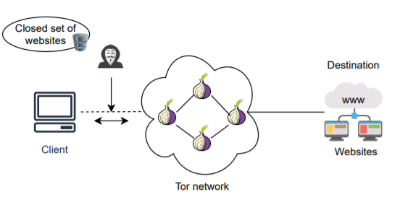
Introduction (contd.)
Adversary here can be from ISP, local network admin, hotspot owners etc.,

Slide 5
Problem Statement
We have set two primary objectives for our project:
Our primary goal is to reimplement the paper which is presented at NDSS Symposium 2018 and to validate their results. We have implemented a CNN based Deep Learning model using PyTorch to design the Neural Network based Website Fingerprinting attack on Tor Network.
We have also implemented alternative approaches using traditional Machine Learning algorithms which are less complex compared to the deep learning models
Rimmer, V., Preuveneers, D., Juarez, M., Goethem, T. V., &amp; Joosen, W. (2018). Automated website fingerprinting through Deep Learning. Proceedings 2018 Network and Distributed System Security Symposium. https://doi.org/10.14722/ndss.2018.23105

Slide 6
Approach
Our primary focus is to implement the Convolutional Neural Network using PyTorch where in the paper used Keras and Theano in their implementation.
The data collected in the paper is in the form of compressed NumPy files (.npz). After extracting the files, the file size for the compressed dataset of 900 websites with 2500 traces each in the Closed World data set is around 4.7 GB.
Due to resource constraints, we have considered the implementation from these datasets for 100 websites.
For the dataset of 100 websites with 2500 traces each, the uncompressed data size is 2.33 GB.

Slide 7
Approach (contd.)
The solution proposed by the authors is to leverage a deep learning-based model. Now, the key advantages of this approach are:
Easy to maintain models even if input patterns change by just retraining the model for feature learning.
Algorithmic transparency given the nature of any deep learning model as the model cannot be exploited of its features making the defender not able to conceal the features that our model has learned.
Can be parallelized with GPUs

Slide 8
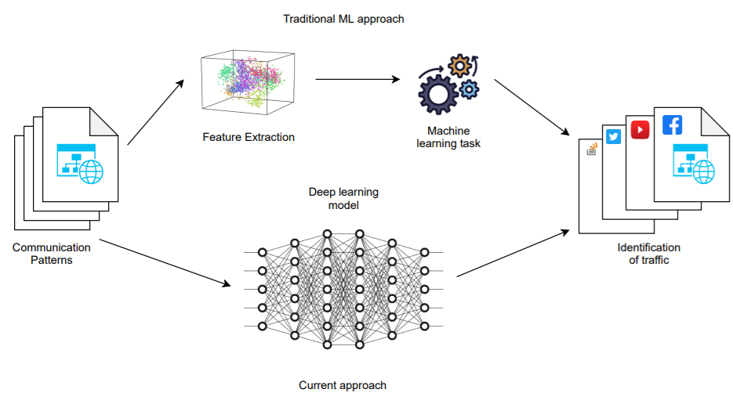
Approach (contd.)

Slide 9
Experimental Setup
Software Specifications: Python 3.9, Anaconda, Jupyter Notebooks, Google Colab, VS Code Editor
Hardware Specifications: i7-7500U processor, 8 GB RAM, Nvidia GeForce 940 MX GPU with 4GB of memory
Packages: numpy, pandas, scikit-learn, PyTorch, Tensorboard
GPU setup required for training:
Installation of Nvidia GeForce experience and Nvidia control panel
Installation of drivers for CUDA 10.1 and toolkit for CUDA 10.1

Slide 10
Dataset Collection
In general, deep learning models require a lot of training data as the number of parameters to be tuned are high, partly due to the higher number of hidden layers and also with lesser data the model tends to overfit the data.
The authors built a distributed crawler (with 15 virtual machines and 16 worker threads on each VM) to leverage on the data from hundreds of entry nodes in the Tor network.
Furthermore, since the model does not need any data from the payload itself, the authors leverage network namespaces and tcpdump to isolate and capture the traffic of each Tor process and discard the encrypted payload and just retain the meta-data from the traffic traces.
Some of the useful aspects from this metadata are the timing, size and direction of the packet. The choice of the deep learning model also was dependent on the nature of input data and in this paper these are 1-D sequences of incoming (website to client) and outgoing (client to website) Tor cells encoded as -1 and 1.

Slide 11
Dataset Collection (contd.)
Closed world set: In this group, the adversary assumes that there is a limited set of monitored websites (a tiny fraction of web) that he/she is interested in identifying.
Extract fingerprints/traces of traffic for this closed set of websites and store them.
Capture the actual Tor user traffic between user and Tor network and then match the communication pattern with already stored fingerprints.
Open world set: Here, the attacker assumes that a Tor user can visit any web page(> billions) on the internet and not just on the web pages that the adversary has trained the model on. Here the attacker differentiates between monitored and unmonitored websites. However, as realistic as this setup sounds, it is difficult to gain higher precision on classifying websites in this scenario.

Slide 12
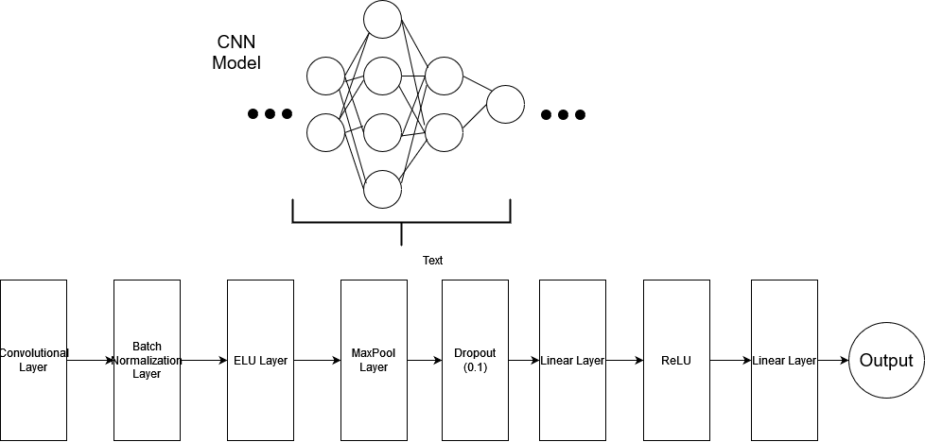
Deep Learning Model

Slide 13
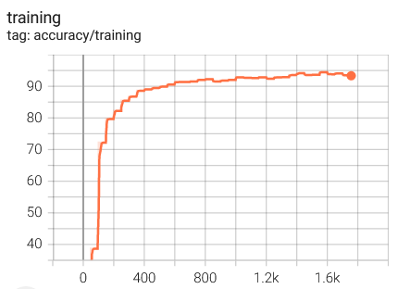
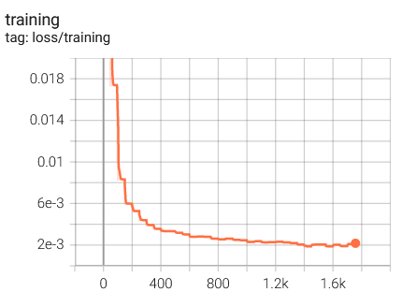
Deep Learning Model

Slide 14
Machine Learning Model
We tried various Machine Learning algorithms on the dataset and the results are shown below
Model | Accuracy | Training Time | Inference Time
K-Nearest Neighbors | 0.28052 | 0.031 seconds | 2112.32 seconds
Adaboost Classifier | 0.01990 | 1280.58 seconds | 31.18 seconds
GaussianNB classifier | 0.31328 | 14.24 seconds | 150.69 seconds
Random Forest | 0.79958 | 163.79 seconds | 3.19 seconds

Slide 15
Machine Learning Model (contd.)
Since Random Forest gave the best results among ML algorithms, so we used hyperparameter tuning to further tune the model.
No. of trees in Random Forest | Accuracy | Training Time | Inference Time
50 | 0.78078 | 71.89 seconds | 1.67 seconds
75 | 0.79278 | 103.74 seconds | 2.27 seconds
100 | 0.79958 | 138.25 seconds | 2.99 seconds
125 | 0.80378 | 174.92 seconds | 3.68 seconds

Slide 16
Results
96.26%
Accuracy achieved by the authors of the paper (CNN)
94.02%
Accuracy achieved by our Deep Learning Model
80.37%
Accuracy achieved by Random Forest Model

Slide 17
Key Learnings
Learned about network security approach towards the onion routing and website fingerprinting.
Similar approach can be implemented for decentralized financial networks like cryptocurrency to predict the potential loopholes in the blockchain network.
This increases up the research scope in the domain of network security to simulate the attacks and analyse the risks.

Slide 18
Conclusion
As we observed from the results, traditional Machine Learning algorithms gives lesser accuracy as compared to the Deep Learning Models.
This is because in the Machine Learning algorithms, the user needs to manually perform feature engineering in order to obtain good performance.
However, Neural Networks automate the process of feature extraction. Due to which, the Deep Learning models perform significantly better.

Slide 19
Thank you!

